Slide 1
Selected area electron diffraction
Parallel incoming electron beam and a selection aperture in the image plane.
Diffraction from a single crystal in a polycrystalline sample if the aperture is small enough/crystal large enough.
Orientation relationships between grains or different phases can be determined.
~2% accuracy of lattice parameters
  Convergent electron beam better
Image plane

Slide 2
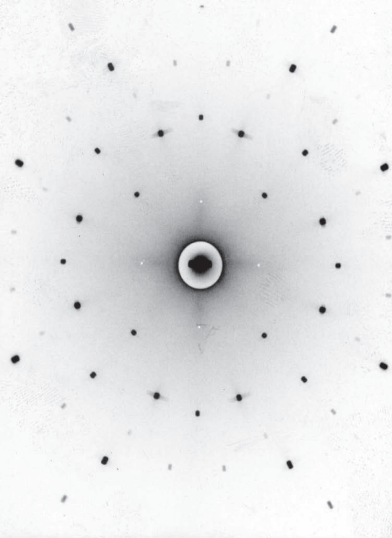
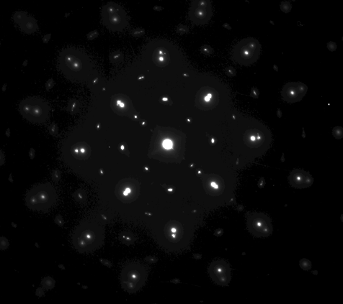
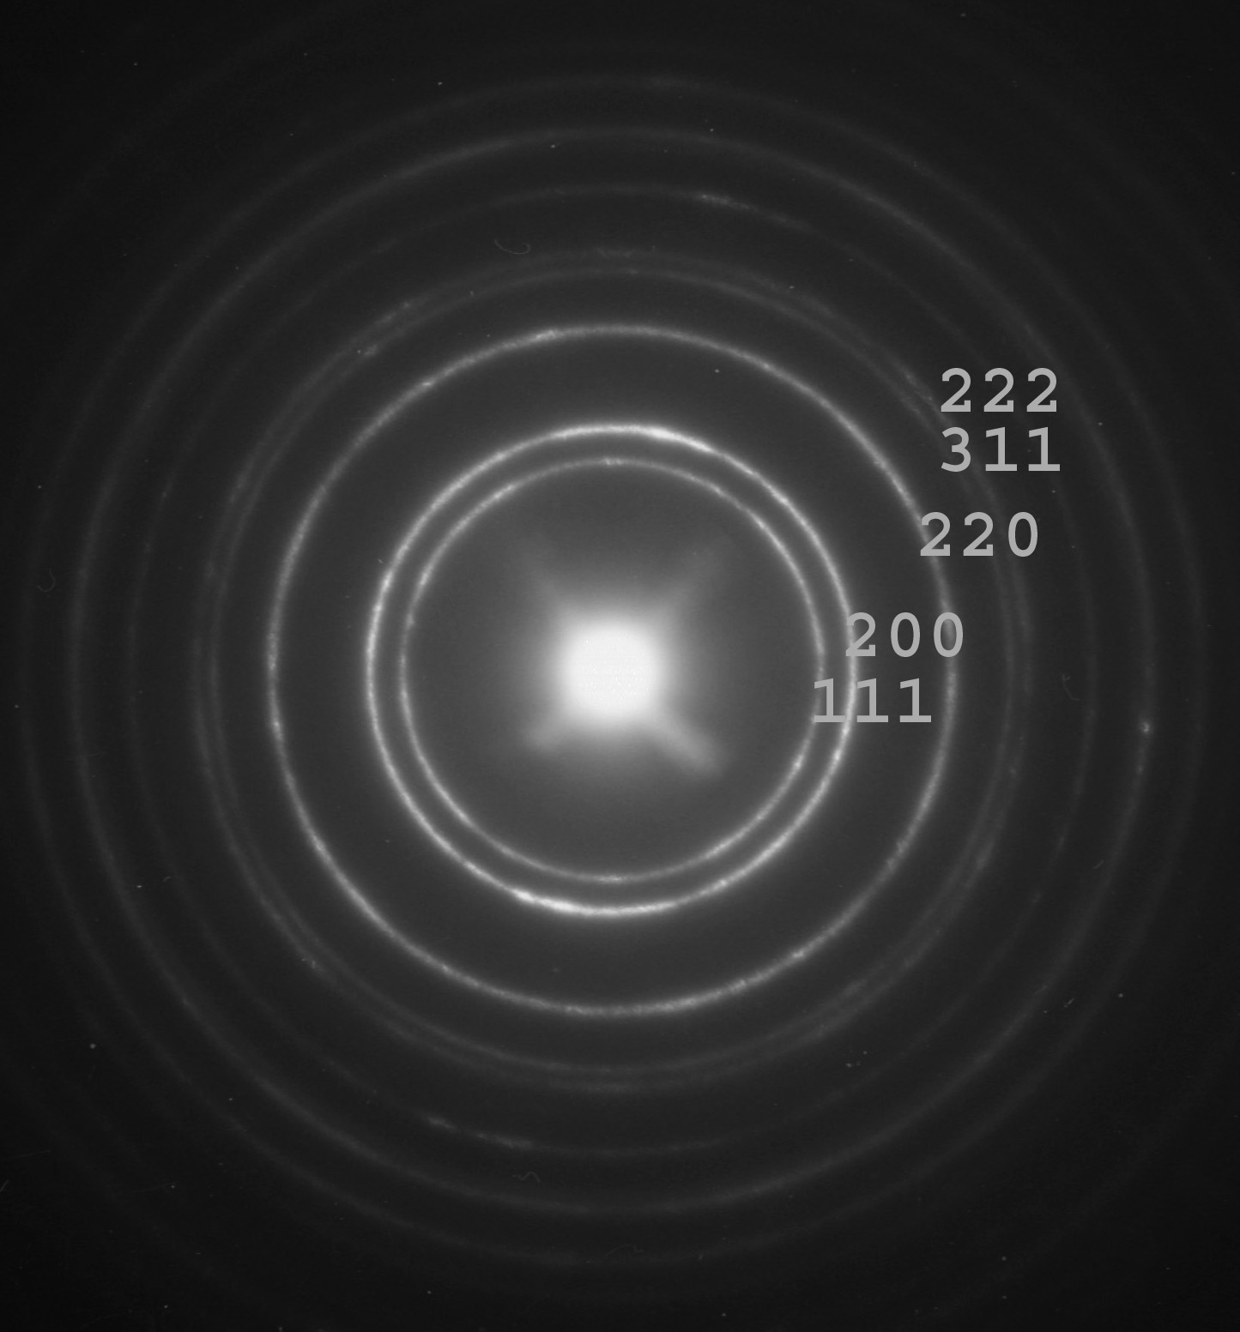
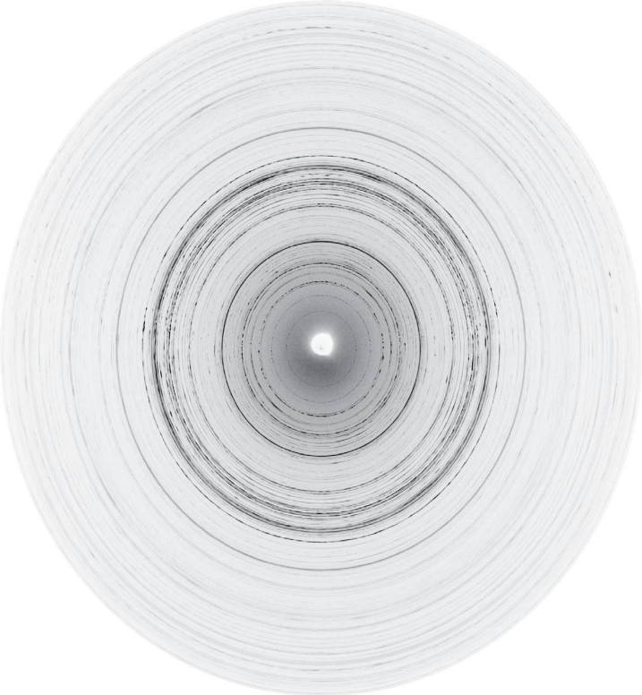
Diffraction with large SAD aperture, ring and spot patterns
Poly crystalline sample
Four epitaxial phases
Similar to XRD from polycrystalline samples.
The orientation relationship between the
phases can be determined with ED.

Slide 3
Higher order reflections, Laue zones
2d sinθ = nλ
λ_{200kV} = 0.00251 nm
Θ~1º
I(k’-k)I=(2/λ)sinθ_{B}=g
The intensity distribution
around each reciprocal
lattice point is spread out
in the form of spikes directed
normal to the specimen
Ewald sphere
(Reflecting sphere)
From one set of planes we only
get one reflected beam
-The Bragg angle increases with
increasing order (n)
-Tilt sample or beam to satisfy
Bragg condition of higher order
reflections.
2θ
k
k’
k=1/λ
First order Laue zone
g
Zero order Laue zone
(see figure 2.35 text book)

Slide 4
Double diffraction, extinction thickness
Double electron diffraction leads to oscillations in the diffracted intensity with increasing thickness of the sample
  No double diffraction with XRD, kinematical intensities
  Forbidden reflection may be observed
t₀: Extinction thickness
  Periodicity of the oscillations
  t₀=πV_{c}/λIF(hkl)I
Incident beam
Diffracted beam
Doubly
diffracted beam
Transmitted
beam
Wedge shaped TEM sample
t₀

Slide 5
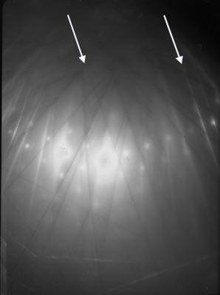
Kikuchi lines
Used for determination of:
crystal orientation
-lattice parameter
-accelerating voltage
-Burgers vector
Deficient
Excess
θB
θB
2θB
Objective lens
Diffraction plane
Deficient
line
Excess
line
http://www.doitpoms.ac.uk/index.html
http://www.doitpoms.ac.uk/tlplib/diffraction-patterns/kikuchi.php
1/d

Slide 6
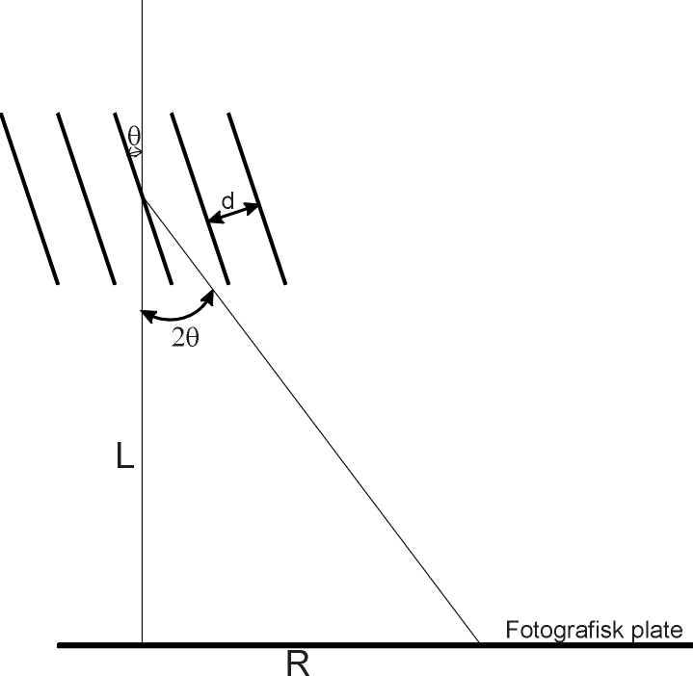
Camera constant
R=L tan2θ_{B} ~ 2Lsinθ_{B}
2dsinθ_{B} =λ
↓
R=Lλ/d
Camera constant:
K=λL
Film plate

Slide 7
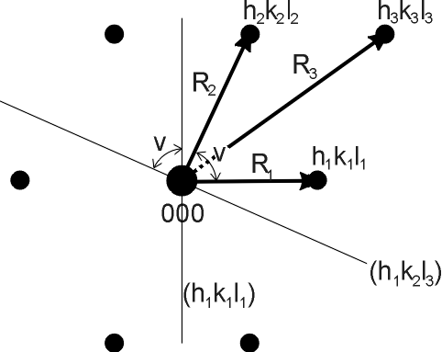
Indexing diffraction patterns
The g vector to a reflection is normal to the corresponding (h k l) plane and IgI=1/d_{nh nk nl}
Measure R_{i} and the angles between
the reflections
- Calculate d_{i} , i=1,2,3 (=K/R_{i})
Compare with tabulated/theoretical
calculated d-values of possible phases
Compare R_{i}/R_{j} with tabulated values for
cubic structure.
g_{1,hkl}+ g_{2,hkl}=g_{3,hkl} (vector sum must be ok)
Perpendicular vectors: g_{i} ● g_{j} = 0
Zone axis: g_{i} x g_{j} =[HKL]_{z}
All indexed g must satisfy: g ● [HKL]_{z}=0
(h₂k₂l₂)
Orientations of corresponding
planes in the real space

Slide 8
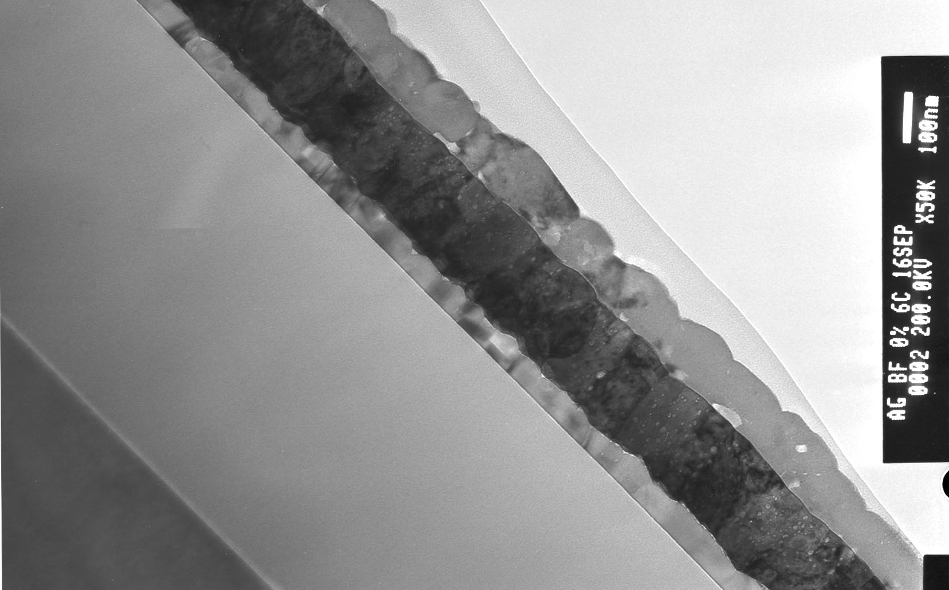
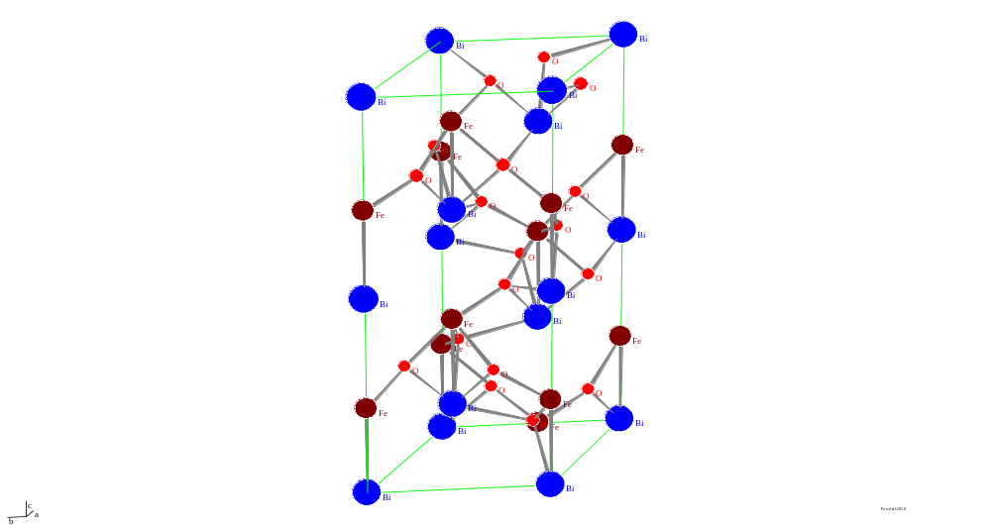
Example: Study of unknown phase in a BiFeO₃ thin film
Metal organic compound on Pt
Heat treatment at 350ºC (10 min) to remove organic parts.
Process repeated three times before final heat treatment at 500-700 ºC (20 min) .
(intermetallic phase grown)
BiFeO₃
Pt
TiO₂
Lim
SiO₂
Si
200 nm
Goal:
BiFeO₃ with space grupe: R3C
and celle dimentions:
a= 5.588 Å c=13.867 Å

Slide 9
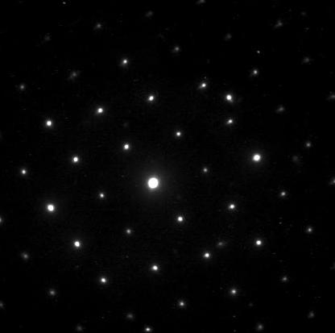
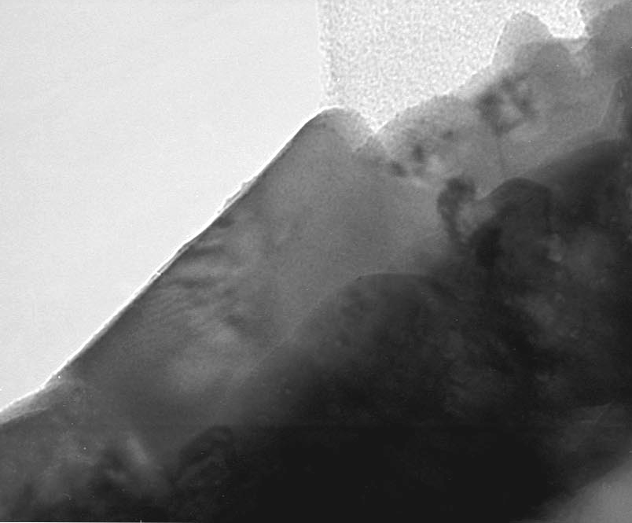
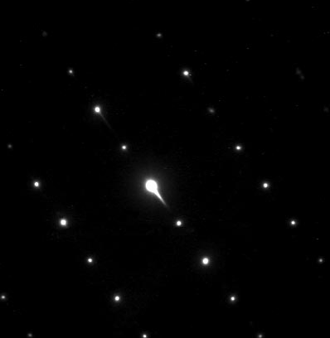
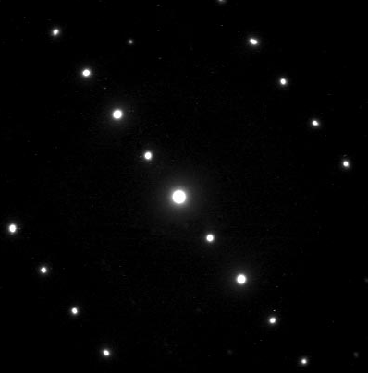
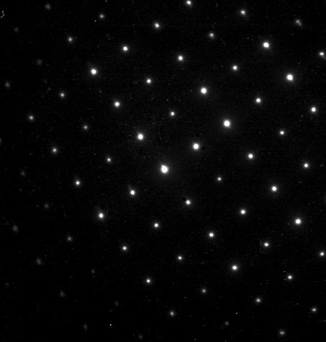
Determination of the Bravais-lattice of an unknown crystalline phase
Tilting series around common axis
27º
50 nm
15º
10º
0º

Slide 10
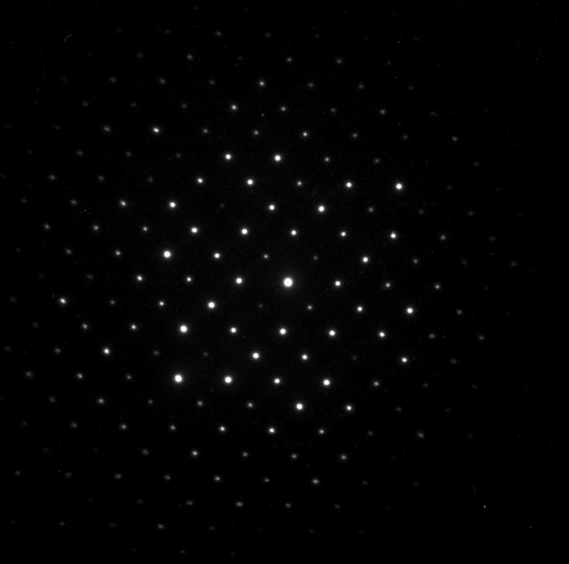
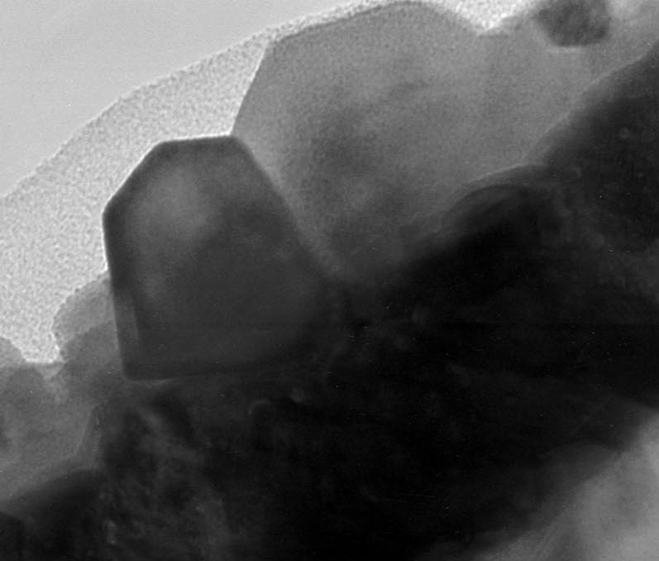
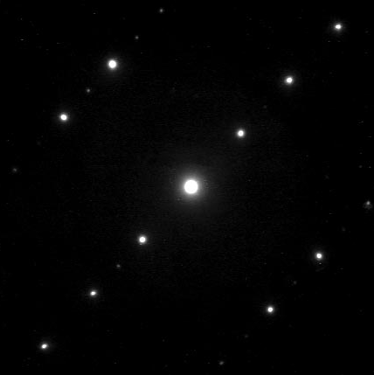
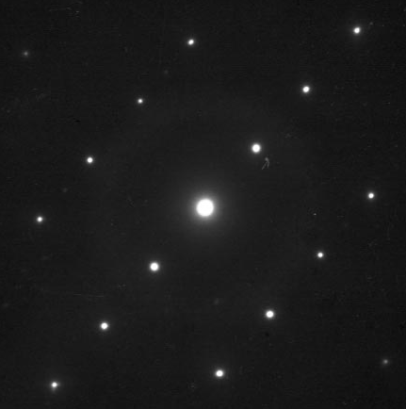
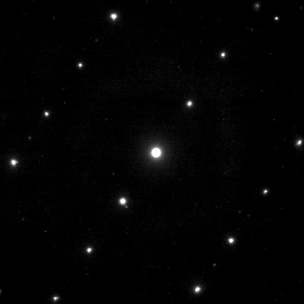
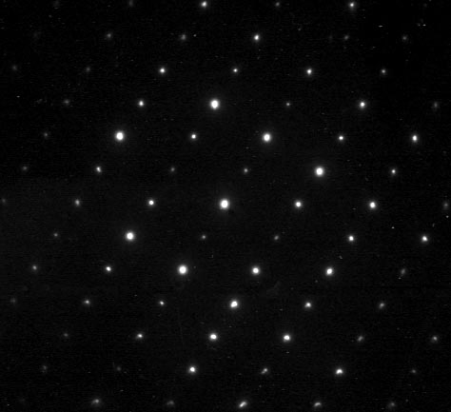
Determination of the Bravais-lattice of an unknown crystalline phase
Tilting series around a dens row of
reflections in the reciprocal space
0º
50 nm
19º
Positions of the
reflections in the
reciprocal space
25º
40º
52º

Slide 11
Bravais-lattice and cell parameters
011
111
001
101
c
b
010
110
[011]
[100]
[101]
100
d = L λ / R
a
From the tilt series we find that the unknown phase
has a primitive orthorhombic Bravias-lattice with
cell parameters:
a= 6,04 Å, b= 7.94 Å og c=8.66 Å
α= β= γ= 90º
6.04 Å
8.66 Å
7.94 Å

Slide 12
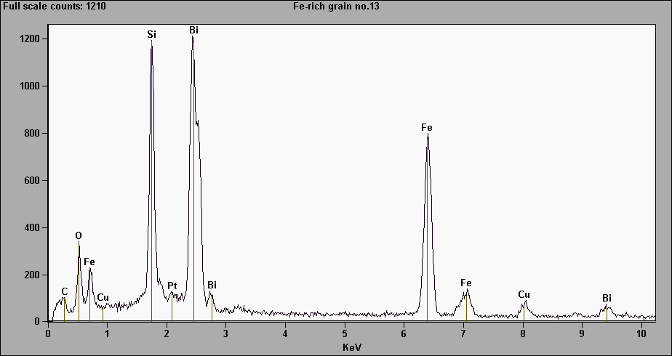
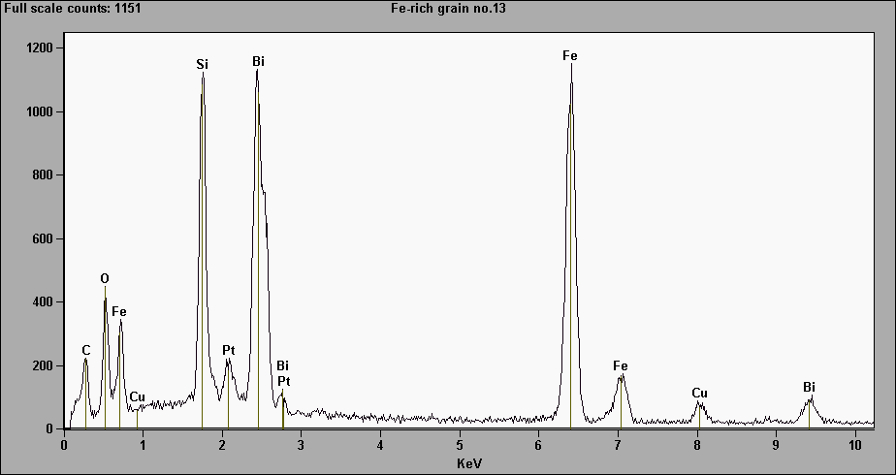
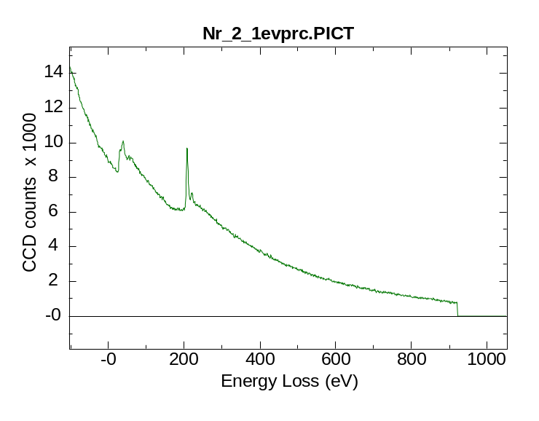
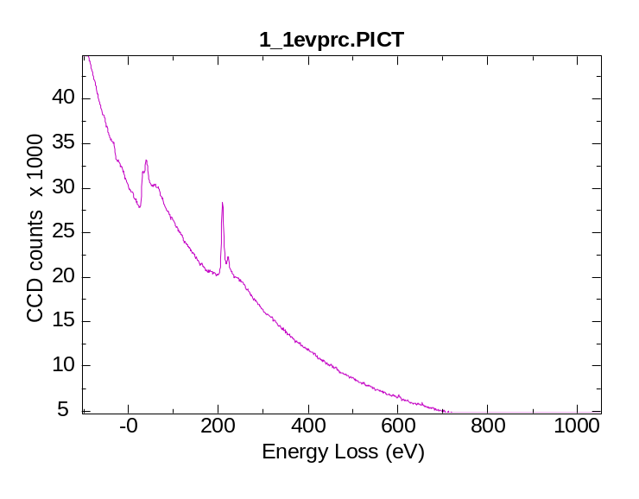
Chemical analysis by use of EDS and EELS
BiFeO₃
Ukjent fase
BiFe₂O₅
O - K
Fe - L2,3
BiFeO₃
Ukjent fase
500 eV forskyvning, 1 eV pr. kanal

Slide 13
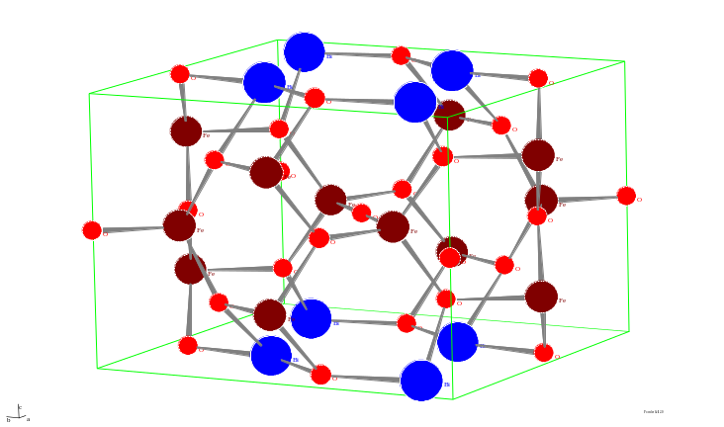
Published structure
A.G. Tutov og V.N. Markin
The x-ray structural analysis of the antiferromagnetic Bi₂Fe₄O₉ and the isotypical combinations Bi₂Ga₄O₉ and Bi₂Al₄O₉
Izvestiya Akademii Nauk SSSR, Neorganicheskie Materialy (1970), 6, 2014-2017.
Romgruppe: Pbam nr. 55, celleparametre: 7,94 Å, 8,44 Å, 6.01Å
x y z
Bi 4g 0,176 0,175 0
Fe 4h 0,349 0,333 0,5
Fe 4f 0 0,5 0,244
O 4g 0,14 0,435 0
O 8i 0,385 0,207 0,242
O 4h 0,133 0,427 0,5
O 2b 0 0 0,5
Celle parameters found with electron diffraction (a= 6,04 Å, b= 7.94 Å and c=8.66 Å) fits reasonably well with the previously published data for the Bi₂Fe₄O₉ phase. The disagreement in the c-axis may be due to the fact that we have been studying a thin film grown on a crystalline substrate and is not a bulk sample. The conditions for reflections from the space group Pbam is in agreement with observations done with electron diffraction.
Conclusion: The unknown phase has been identified as Bi₂Fe₄O₉ with space group Pbam with cell parameters a= 6,04 Å, b= 7.94 Å and c=8.66 Å.

